Slide 1
Project Title: Music Genre classification using Machine learning on FMA dataset Name : Shashank B V Student Id: R00224414 Course: Data science and Analytics Date : 27-08-2023 Supervisor: Vincent Cregan

Slide 2
Introduction
Background
Transition from traditional music media to online streaming platforms
Importance of classifying a diverse and ever-growing array of music genres
Challenges of using traditional classification methods
Problem Statement
Necessity for automated genre classification due to the exponential increase in music data
Complexity of auditory signals
Limitations of manual methods
Aims and Objectives
Create a predictive model using machine learning and deep learning Objectives
Data cleaning and exploratory data analysis
Extract key audio features (MFCCs, Chroma, Tonnetz, ZCR, RMSE, Spectral centroid, Spectral bandwidth, spectral contrast, spectral roll off)
Develop and validate machine learning models.

Slide 3
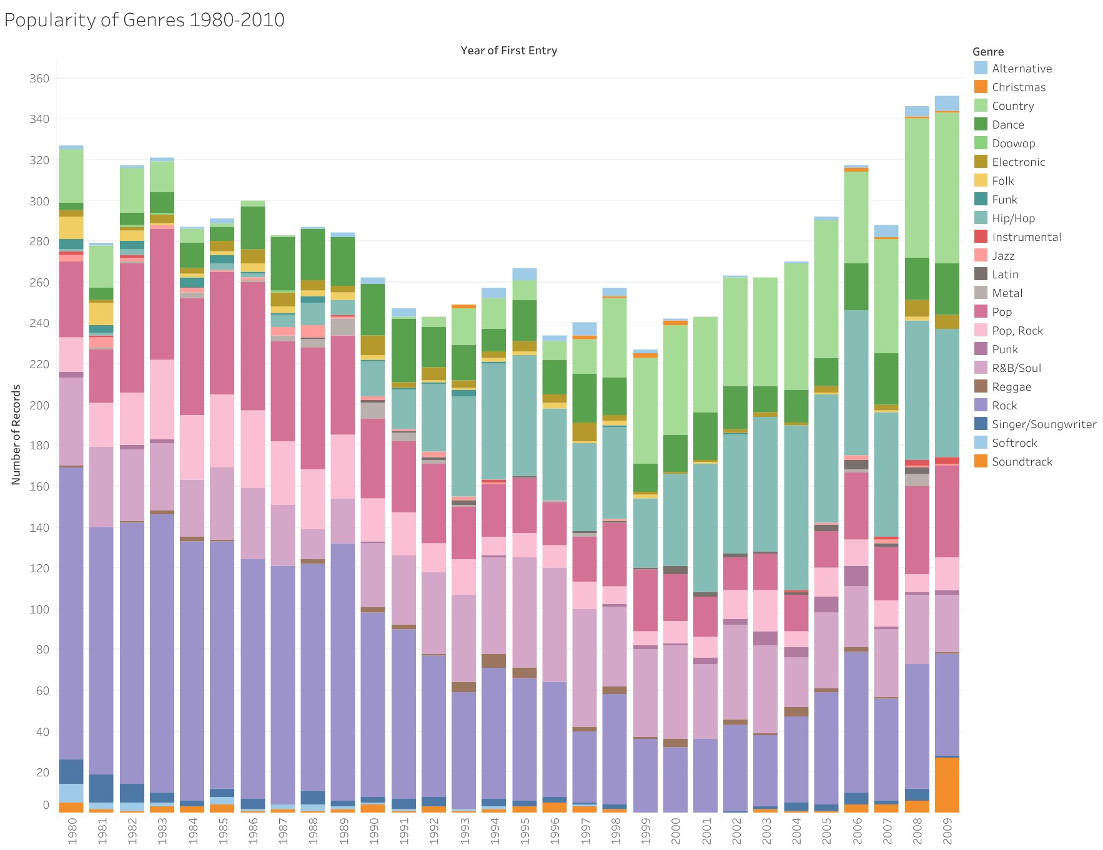
Popularity of musical genres
This graph shows the changes in the popularity of different music genres from 1980 to 2009. You can see the rise of hip-hop and country and the decline of rock. This illustrates how musical tastes are continually changing, further complicating classification effortsThis graph shows the changes in the popularity of different music genres from 1980 to 2009. You can see the rise of hip-hop and country and the decline of rock. This illustrates how musical tastes are continually changing, further complicating classification effort

Slide 4
Research Background
Our project is deeply rooted in the academic research that has shaped the field of music genre classification. Below are some key research papers that have inspired and guided our project.
1. FMA Dataset by Defferrard et al.
Importance: This dataset provides a rich collection of labeled audio files across various genres, serving as the primary data source for our project.
Highlights: The FMA dataset is comprehensive and has been used widely in academic research for genre classification and other machine learning tasks.
2. Mel-Frequency Cepstral Coefficients in Audio Classification by Dr. Emily Thompson
Importance: Dr. Thompson's paper is foundational in using MFCCs for audio classification, a key feature in our model.
Highlights: The paper empirically validates MFCCs' effectiveness in capturing the timbral texture of audio, thereby making it an essential feature for genre classification.
3. Harmonic Content Analysis using Chroma Features by Prof. Richard Lee
Importance: Prof. Lee's work on Chroma features is central to understanding harmonic structures in music.
Highlights: The paper shows how Chroma features can be effectively utilized to distinguish complex harmonic genres like Jazz and Classical.

Slide 5
Dataset
Source: FMA dataset from GitHub
Characteristics: 106,574 tracks, 16,341 artists, 14,854 albums, 161 genres
Tracks: The dataset contains a massive collection of 106,574 individual tracks. This extensive library offers us a rich diversity in terms of audio characteristics, enabling a more comprehensive study.
Artists: There are 16,341 unique artists represented in this dataset. The large number of artists ensures that we're not biased toward any particular style, providing a broad look into the world of music.
Albums: With 14,854 albums included, the dataset offers an opportunity to explore albums as a whole, as well as individual tracks. This could be particularly useful for understanding stylistic coherence within an album or an artist's work.
Genres: One of the most important characteristics is the inclusion of 161 unique genres. This allows us to dive deep into the characteristics that define each genre, enabling highly detailed classification models.

Slide 6
Mthodology
1. Data Pre-processing
2. Feature Extraction
3. Model Development
4. Model Evaluation

Slide 7
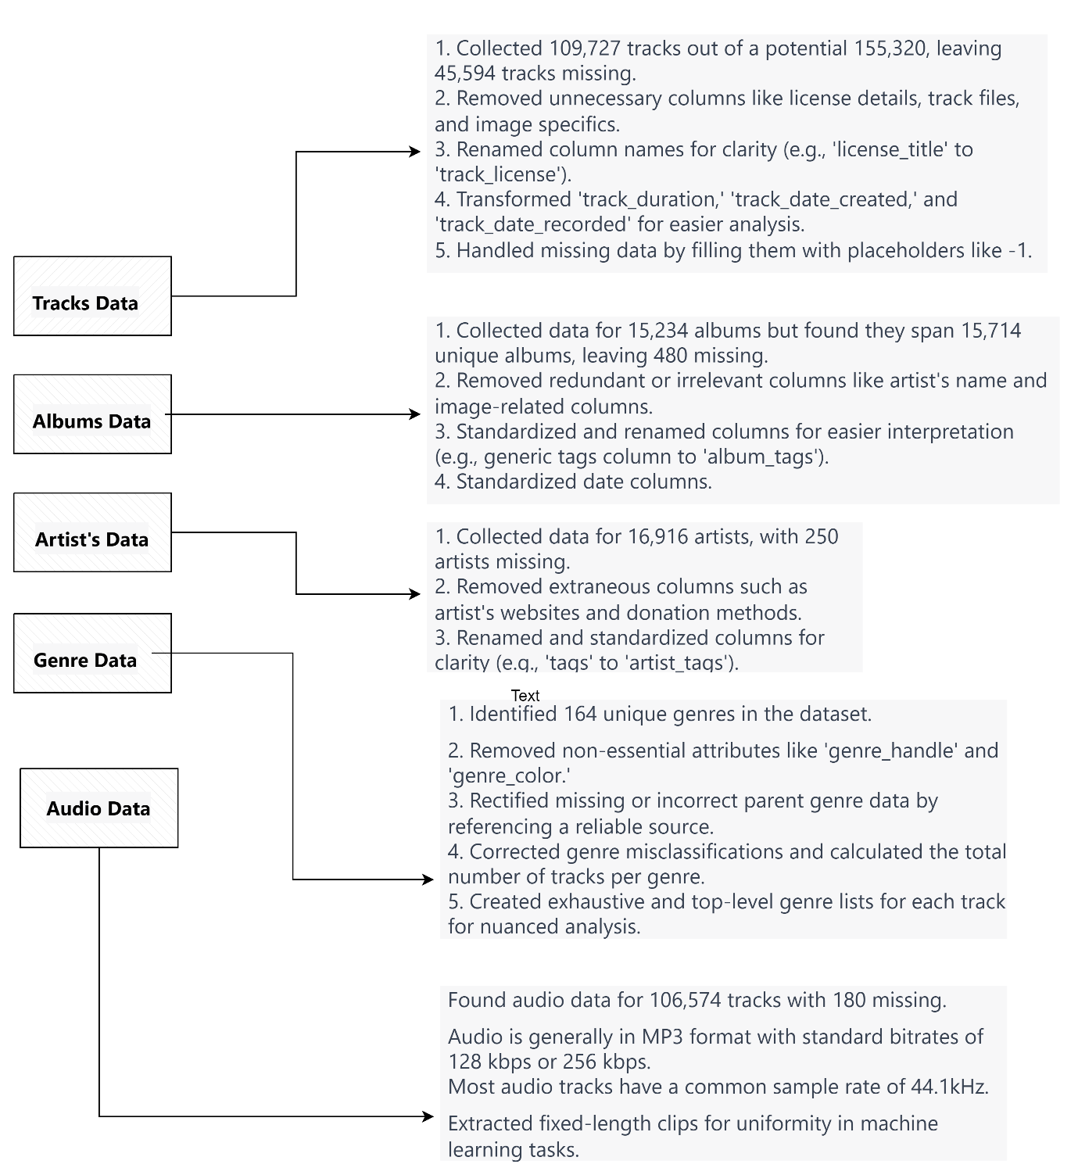
Data cleaning

Slide 8
Feature Extraction
Role of Feature Extraction in Music Classification
Types of Features Used:
MFCCs
Chroma Features
Zero Crossing Rate
RMSE
Spectral Centroid and Bandwidth
Spectral Contrast and Rolloff
Statistical Moments: Mean, Std Dev, Skewness, etc.
Error Handling & Optimization
Data Integrity: Saving and validation of features

Slide 9
Model development
k-Nearest Neighbors (kNN):
Strengths: Adapts to complex features, handles class imbalances.
Weaknesses: Computationally intensive due to large dataset.
2.Support Vector Machines (SVC & LinearSVC):
Strengths: Efficiently handles high-dimensional data like MFCCs and Chroma.
Weaknesses: None specified.
Decision Trees (DT) & Random Forests (RF):
Strengths: Good for non-linear data, in-built feature importance metric.
Weaknesses: Computationally intensive due to ensembling in RF.
AdaBoost (Adaptive Boosting):
Strengths: Focuses on difficult-to-classify examples, good for diverse feature set.
Weaknesses: High computational cost.

Slide 10
Multilayer Perceptrons (MLP1 & MLP2):
Strengths: Captures intricate non-linear relationships, versatile.
Weaknesses: Complexity can lead to overfitting.
Naive Bayes (NB):
Strengths: Efficient, good for probabilistic features.
Weaknesses: Assumes feature independence.
Quadratic Discriminant Analysis (QDA):
Strengths: Quadratic decision boundaries, good for non-linearly separable data.
Weaknesses: Assumes Gaussian distribution for each class.

Slide 11
Model Evaluation
Compare Decision Trees (DT), Support Vector Machines (SVC), and Multi-Layer Perceptrons (MLP).
Identify best classifier-feature set combo for multi-label music genre classification.
Methods:
Decision Trees (DT)
Adapted for multi-label tasks using OneVsRest classifier.
Support Vector Machine (SVC)
Also adapted for multi-label tasks using OneVsRest.
Multi-Layer Perceptron (MLP)
Inherently supports multi-label tasks.
Max 700 iterations for computational efficiency.
Feature Sets:
Set 1: Only Mel Frequency Cepstral Coefficients (MFCC)
Set 2: MFCC + Spectral contrast + Chroma + Spectral centroid + Tonnetz
Set 3: Set 2 but replace Tonnetz with Zero-Crossing Rate (ZCR)
Performance Metrics:
Classification Accuracy
Primary metric for model effectiveness.
Particularly useful for balanced class distribution.

Slide 12
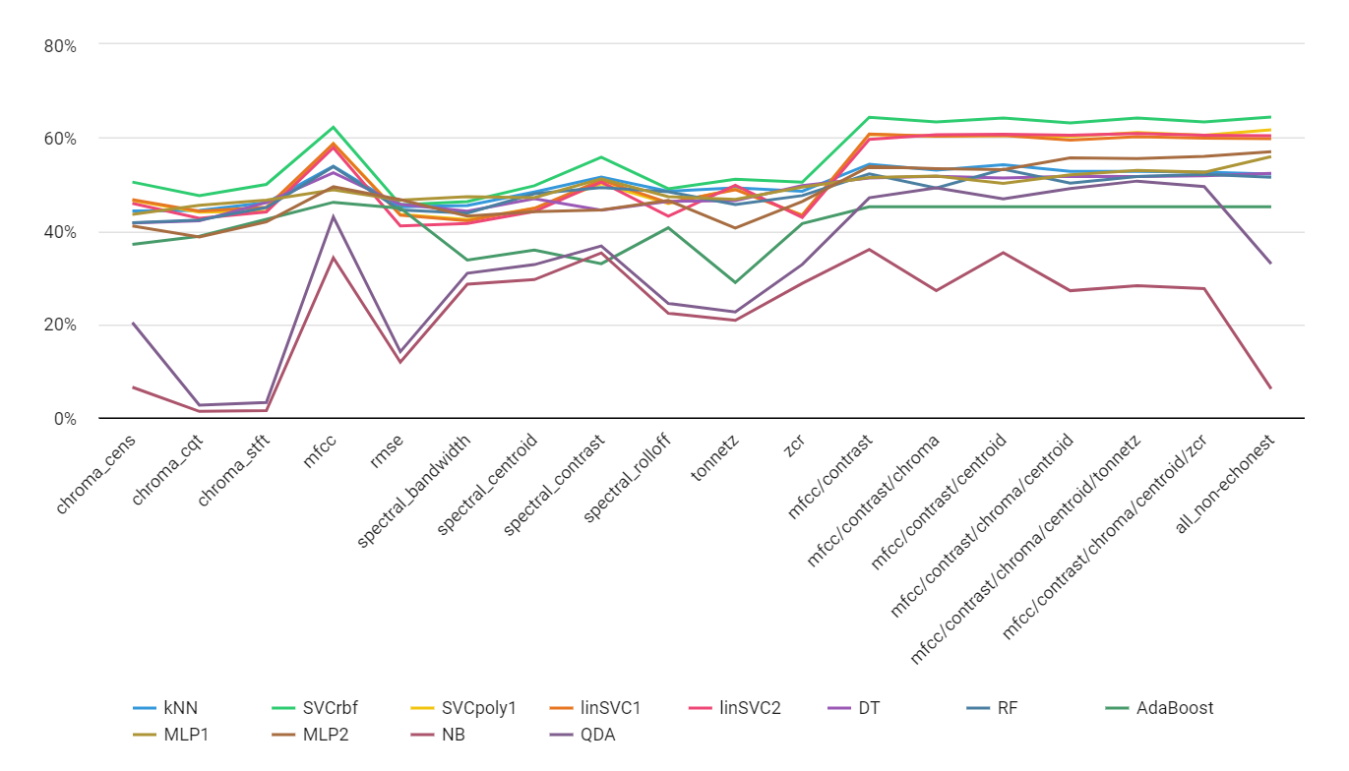
Results
Comparison of Model Performances
Range of accuracy across models (e.g., kNN: 53.87% vs 44.28%)
Best and worst performers (e.g., SVCrbf: 64.34%, NB and QDA: <10%)
Impact of feature sets on performance (e.g., 'mfcc/contrast': Highest accuracy)

Slide 13
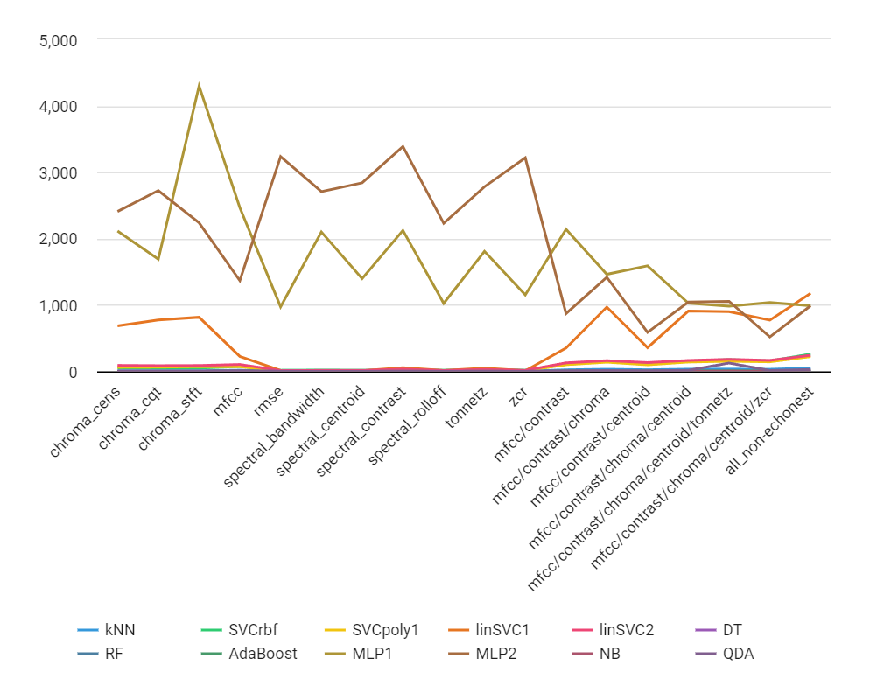
Computational Time
Fastest and slowest models (e.g., DT: 0.1307 ms, MLP: 4298.1025 ms)
Trade-off between accuracy and computational time (e.g., MLP vs DT)
Evaluation Metrics Table
Table 4.3.1 highlights (e.g., SVC highest accuracy but longer time, DT fastest but less accurate)

Slide 14
Discussion, Conclusion and Future Work
Key Findings
Varied performance among classifiers.
Importance of feature selection.
Trade-off between accuracy and computational time.
Limitations
Computational constraints.
Lack of evaluation on advanced neural networks (CNNs, RNNs).
Future Work
Feature engineering techniques like PCA, t-SNE.
Incorporate advanced neural networks.
Ensemble methods.
Dataset augmentation.
Method evaluation like F-score, precision

